Slide 2
FULLSTACK
Development
Design + Behavior + Server Logic + Database

Slide 3
Design?
Using HTML/Framework Components to Design the Visual Appearance

Slide 4
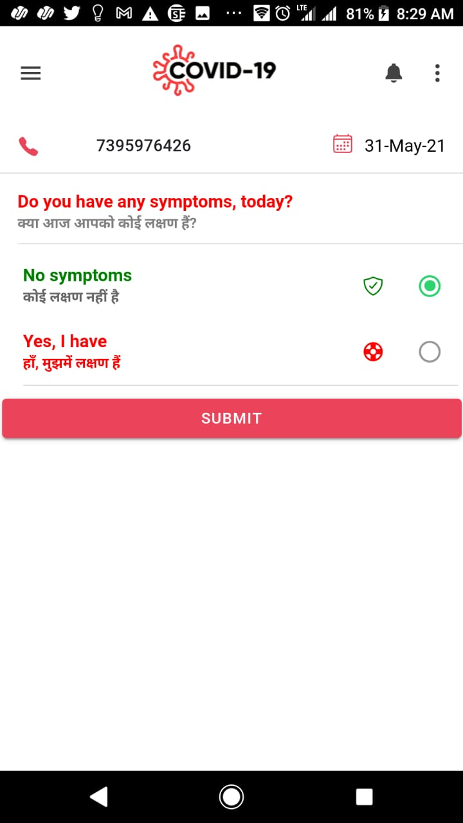

Slide 5
i
B
eha vor?
Handling User Interactions with the Design

Slide 7
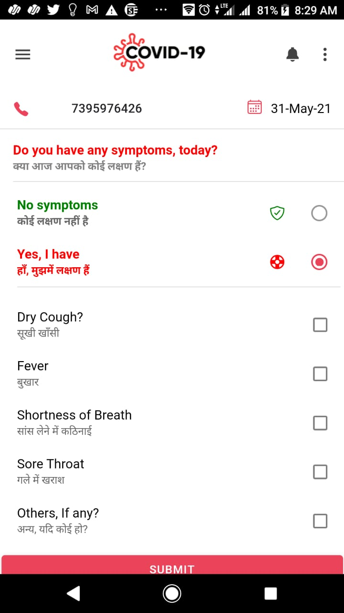

Slide 11
Server Logic
Fetch User Data ----- Check + Clean + Transform ------- CRUD in DB
(BUSINESS LOGIC)

Slide 12
SQL DB

Slide 13
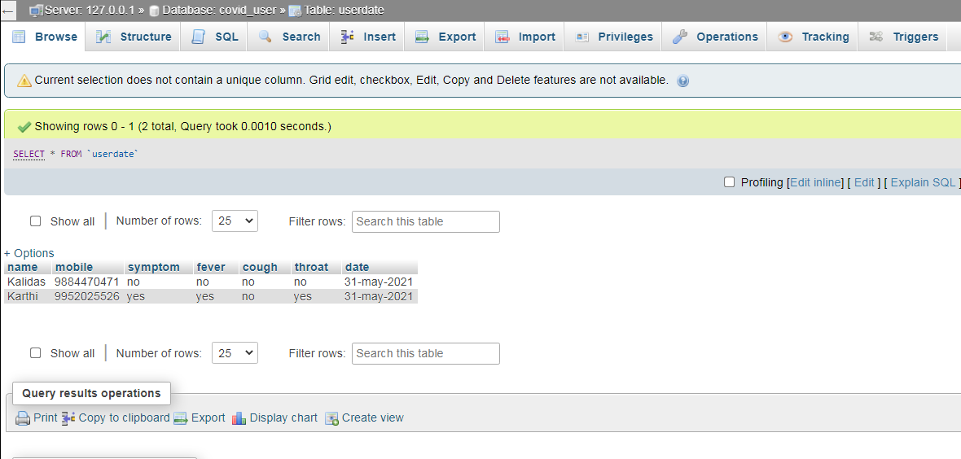

Slide 14
NOSQL DB

Slide 15
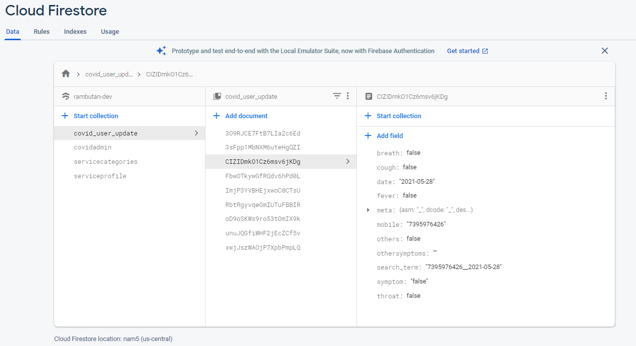

Slide 16
Tools Collection

Slide 17













Design Tools
Behavior Tools
Server Scripting
Database

Slide 18
Design Tools
Behavior Tools
Server Scripting
Database

